Slide 1

Module 3
Deep Learning: Feed-Forward Architectures
Notes:
Guidelines
Use section headers to chunk content in your presentation.
Use the same style of section header throughout your presentation.
Keep your title to no more than 2 lines.

Slide 2
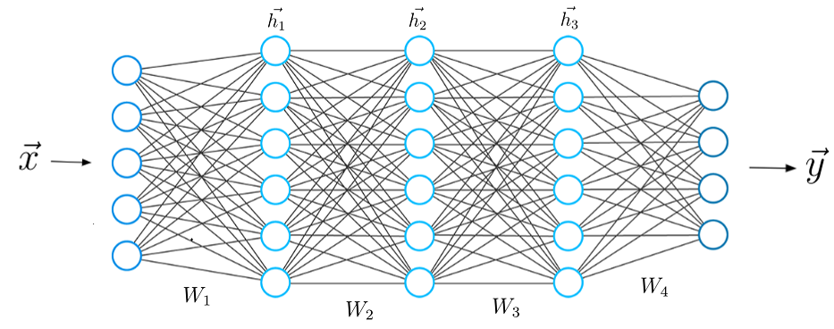
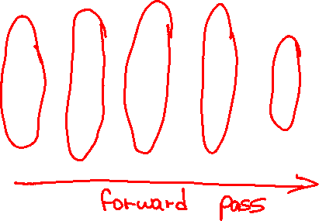
DL: Feed-Forward Architectures
Notes:
Guidelines
Use a title slide at the beginning of your presentation. There are 9 variations of title slides to choose from.
If you will have a series of slideshows, we recommend using the same style of title slide for each presentation.
Keep your title to no more than 2 lines.
Do not change the font style or font size of the title or subtitle.

Slide 3
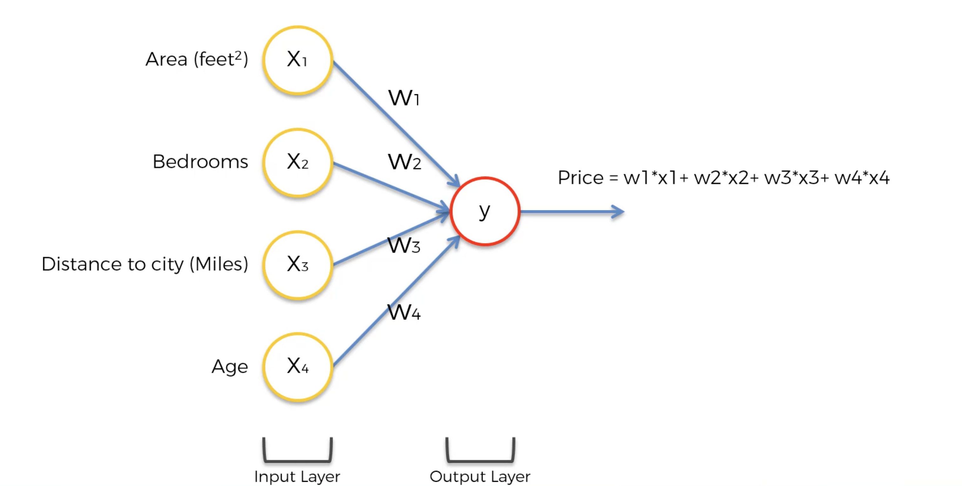
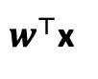
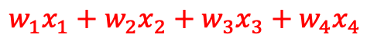
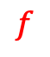
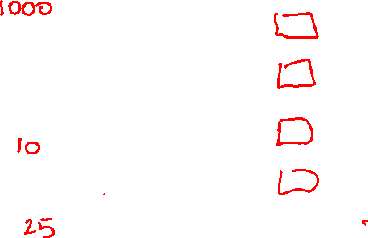

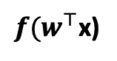
The Forward Pass
Input nodes ▻ hidden nodes ▻ output nodes
This is called the forward pass
$$∑$$
$$w_{1}x_{1}+w_{2}x_{2}+w_{3}x_{3}+w_{4}x_{4}$$
$w^{⊤}$x
$$f$$
${f(w}^{⊤}$x)

Slide 4
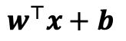
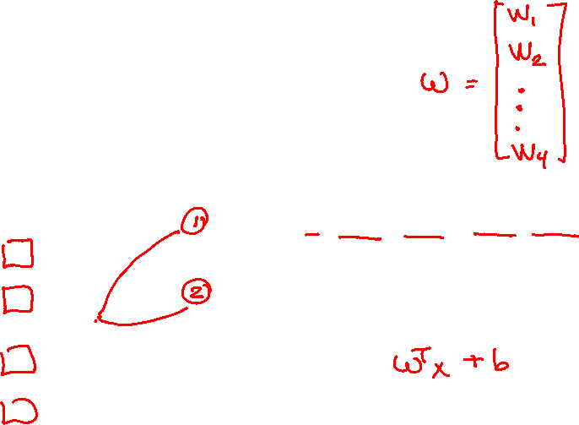
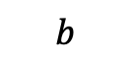
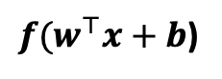
The Forward Pass
Input nodes ▻ hidden nodes ▻ output nodes
This is called the forward pass
1
$$∑$$
$${b+w}_{1}x_{1}+w_{2}x_{2}+w_{3}x_{3}+w_{4}x_{4}$$
$w^{⊤}x+b$
$$b$$
$$f$$
$f(w^{⊤}x+b$)

Slide 5
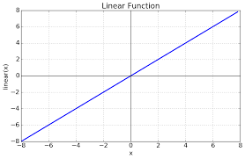
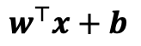
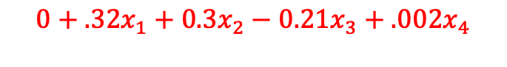
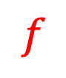
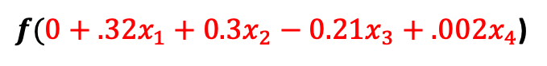
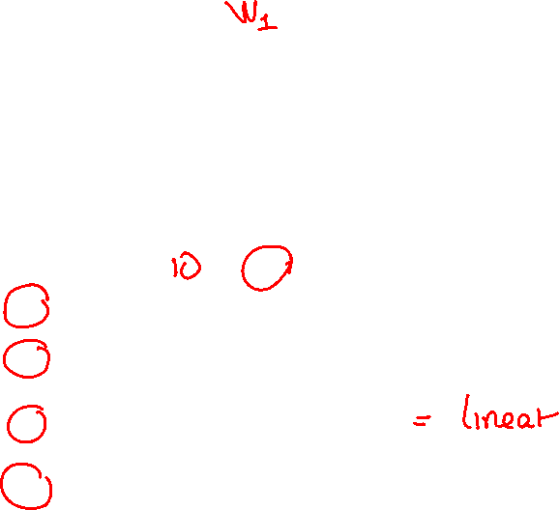
The Forward Pass
Input nodes ▻ hidden nodes ▻ output nodes
This is called the forward pass
1
$$∑$$
$$0+.32x_{1}+0.3x_{2}−0.21x_{3}+.002x_{4}$$
$w^{⊤}x+b$
$$b$$
$$f$$
$f(0+.32x_{1}+0.3x_{2}−0.21x_{3}+.002x_{4}$)
$$f$$

Slide 6
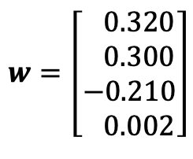

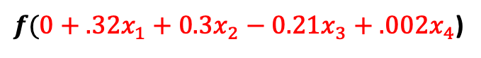
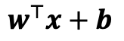
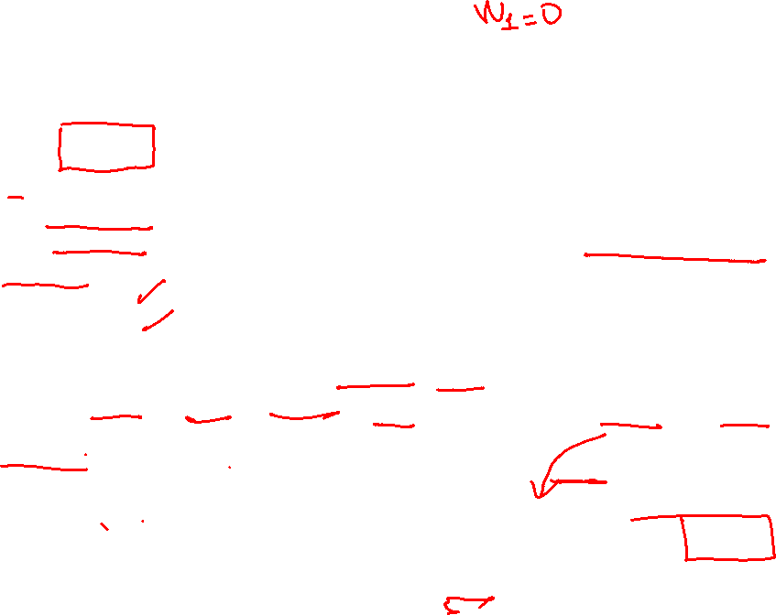
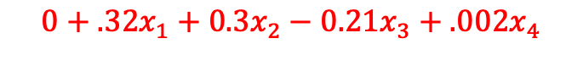
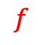
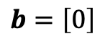
Parameter Initializers
Setting initial values of model’s weights and biases before training
Zero initializations
Advantages: computational complexity,
Disadvantages: all neurons learning similar features (symmetry learning)
Random Initialization
Normal
Uniform
Advantages: random initialization avoiding symmetry,
Disadvantages: if values are too large/small, issues with sigmoid and tanh activations
Xavier Glorot (tanh, sigmoid), He (ReLu), Lecun (sigmoid, tanh normalized)
Orthogonal (RNNs)
Weights (kernels)
Biases (intercepts)
$$∑$$
$$0+.32x_{1}+0.3x_{2}−0.21x_{3}+.002x_{4}$$
$$w=\left[\begin{matrix} 0.320 \\ 0.300 \\ −0.210 \\ 0.002\end{matrix}\right]$$
$w^{⊤}x+b$
$$b=\left[0\right]$$
$$f$$
$f(0+.32x_{1}+0.3x_{2}−0.21x_{3}+.002x_{4}$)

Slide 7
Python
Notes:
Guidelines
Use a title slide at the beginning of your presentation. There are 9 variations of title slides to choose from.
If you will have a series of slideshows, we recommend using the same style of title slide for each presentation.
Keep your title to no more than 2 lines.
Do not change the font style or font size of the title or subtitle.

Slide 8
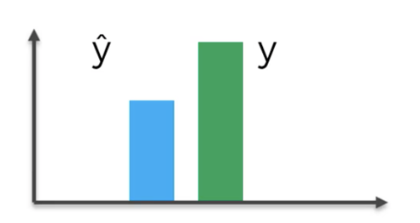
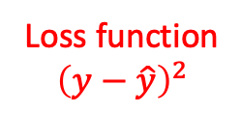
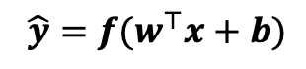
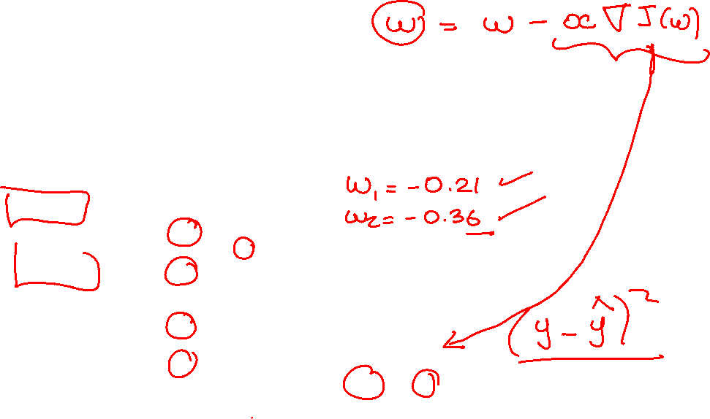
The Forward Pass
Input nodes ▻ hidden nodes ▻ output nodes
This is called the forward pass
1
$$b$$
$${ \hat{y}=f(w}^{⊤}x+b)$$
Loss function
$${\left(y−\hat{y}\right)}^{2}$$

Slide 9
The Forward Pass
Input nodes ▻ hidden nodes ▻ output nodes
This is called the forward pass
1
$$b$$
$${ \hat{y}=f(w}^{⊤}x+b)$$
Loss function
$${\left(y−\hat{y}\right)}^{2}$$

Slide 10
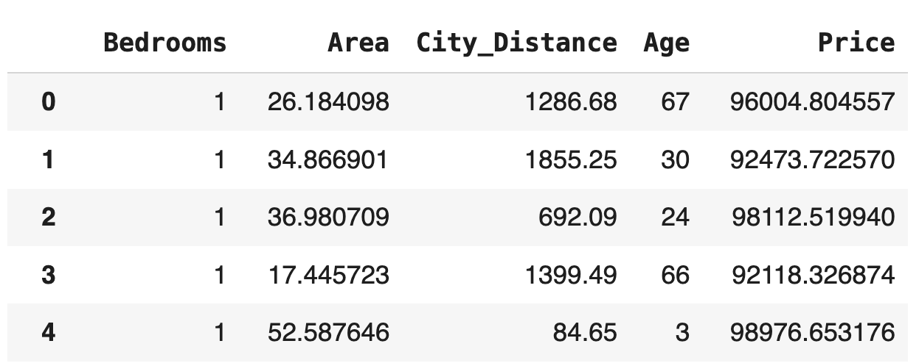
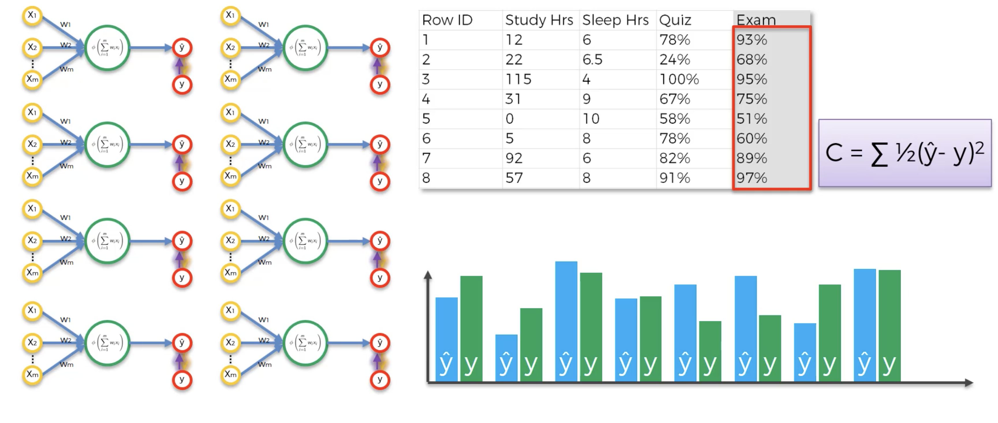
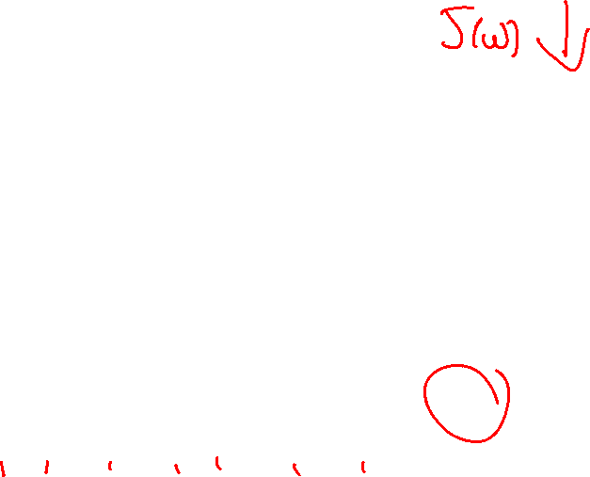
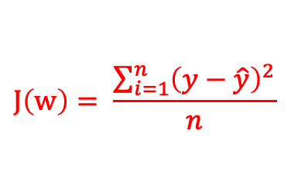
The Forward Pass
Input nodes ▻ hidden nodes ▻ output nodes
This is called the forward pass
$$J\left(w\right)= \frac{\sum_{i=1}^{n}{{\left(y−\hat{y}\right)}^{2}}}{n}$$

Slide 11
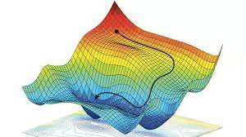
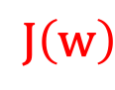
The Forward Pass
Input nodes ▻ hidden nodes ▻ output nodes
This is called the forward pass
$$J\left(w\right)$$
1
$$b$$
$${ \hat{y}=f(w}^{⊤}x+b)$$

Slide 12
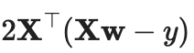

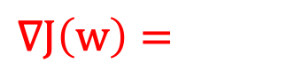
The Forward Pass
Input nodes ▻ hidden nodes ▻ output nodes
This is called the forward pass
$$∇J\left(w\right)=$$
1
$$b$$
$${ \hat{y}=f(w}^{⊤}x+b)$$

Slide 13
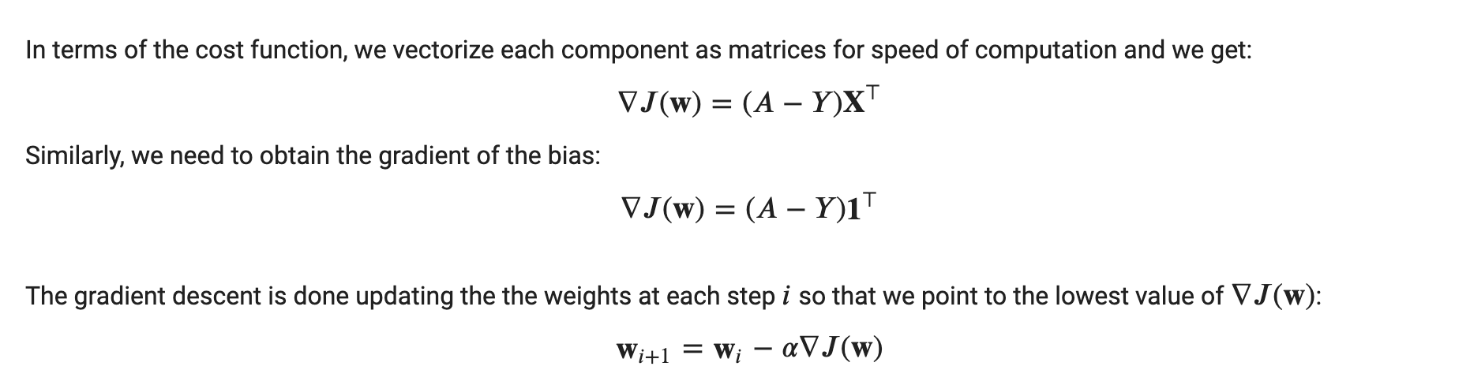
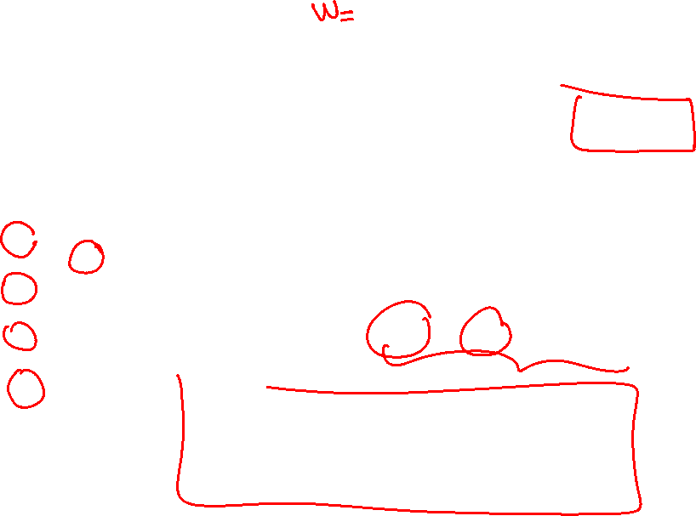
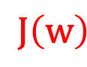
Backward Propagation
$$J\left(w\right)$$
Output nodes ▻ hidden nodes ▻ input nodes
This is called the backward pass
Step size
(learning rate)
1
$$b$$
$${ \hat{y}=f(w}^{⊤}x+b)$$

Slide 14
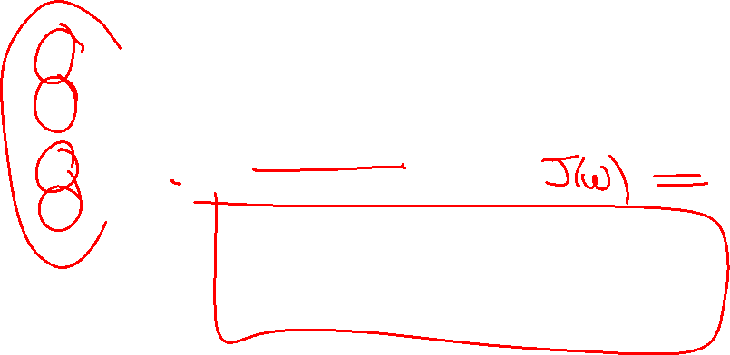

Forward Pass
Input nodes ▻ hidden nodes ▻ output nodes
This is called the forward pass
$$J\left(w\right)$$
1
$$b$$
$${ \hat{y}=f(w}^{⊤}x+b)$$

Slide 15
Backward Pass
Output nodes ▻ hidden nodes ▻ input nodes
This is called the backward pass
Step size
(learning rate)
1
$$b$$
$${ \hat{y}=f(w}^{⊤}x+b)$$

Slide 16
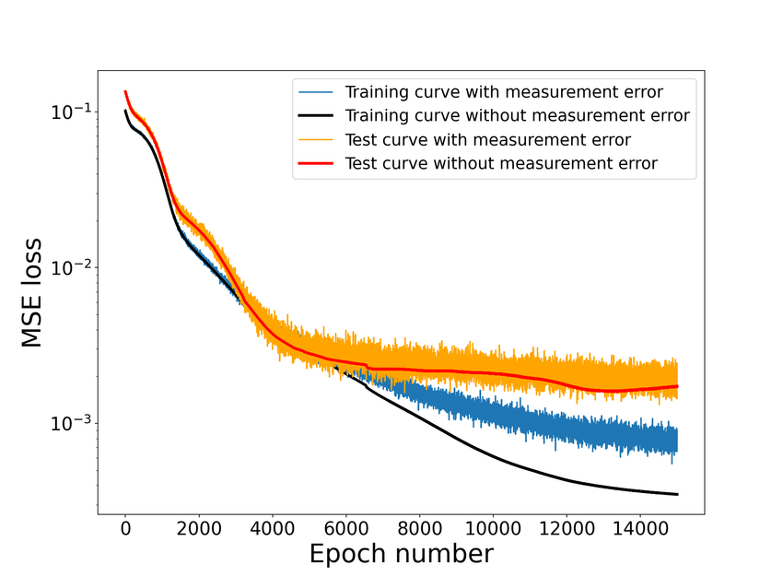
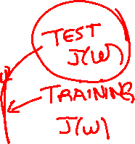
Learning Curve
Output nodes ▻ hidden nodes ▻ input nodes
This is called the backward pass

Slide 17



Please download and install the Slido app on all computers you use
Consider the role of the learning rate in training a neural network. Which of the following statements best describes the effects of choosing a learning rate that is either too small or too large?
ⓘ Start presenting to display the poll results on this slide.

Slide 18
Please download and install the Slido app on all computers you use
Given a learning curve of the training set as given below, what is likely to be case in the training of this model.
ⓘ Start presenting to display the poll results on this slide.

Slide 19
Please download and install the Slido app on all computers you use
Given a learning curve of the training set as given below, what is likely to be case in the training of this model.
ⓘ Start presenting to display the poll results on this slide.

Slide 20
Python
Notes:
Guidelines
Use a title slide at the beginning of your presentation. There are 9 variations of title slides to choose from.
If you will have a series of slideshows, we recommend using the same style of title slide for each presentation.
Keep your title to no more than 2 lines.
Do not change the font style or font size of the title or subtitle.

Slide 21
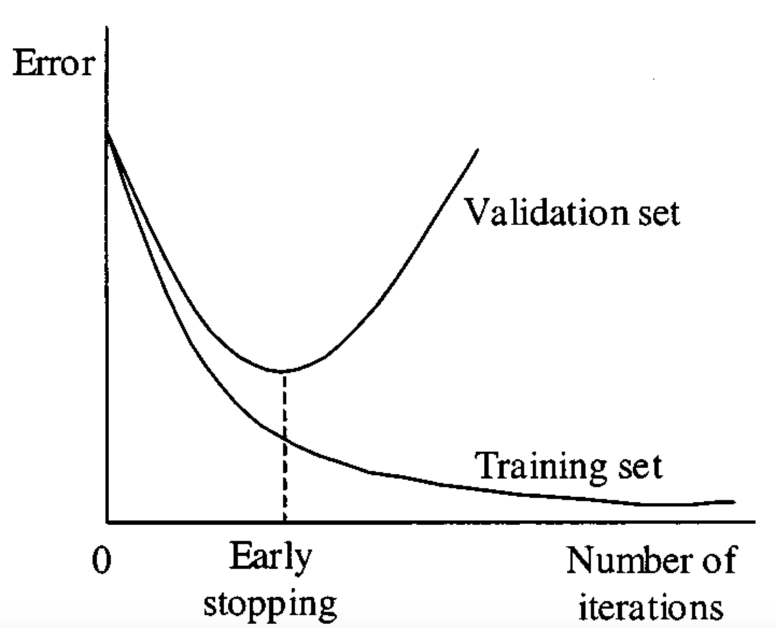
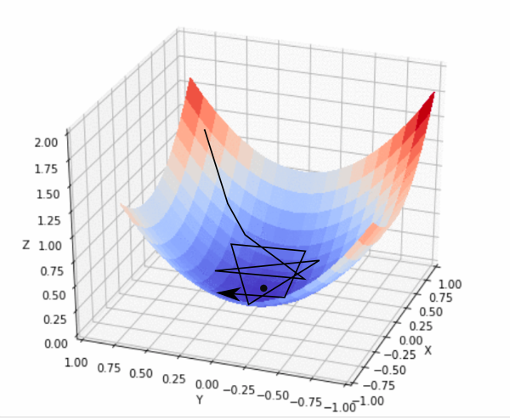
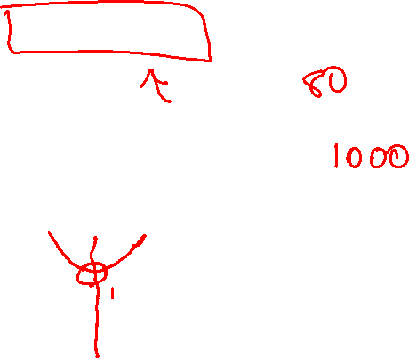
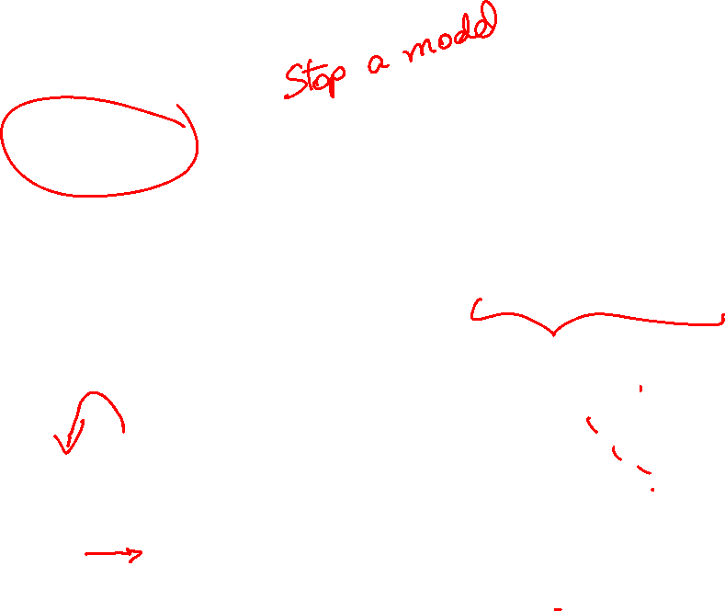
Callbacks
Special functions or methods that can be executed at specific points during the training
Early stopping sops training when the validation loss stops improving

Slide 22
Python
Notes:
Guidelines
Use a title slide at the beginning of your presentation. There are 9 variations of title slides to choose from.
If you will have a series of slideshows, we recommend using the same style of title slide for each presentation.
Keep your title to no more than 2 lines.
Do not change the font style or font size of the title or subtitle.

Slide 23
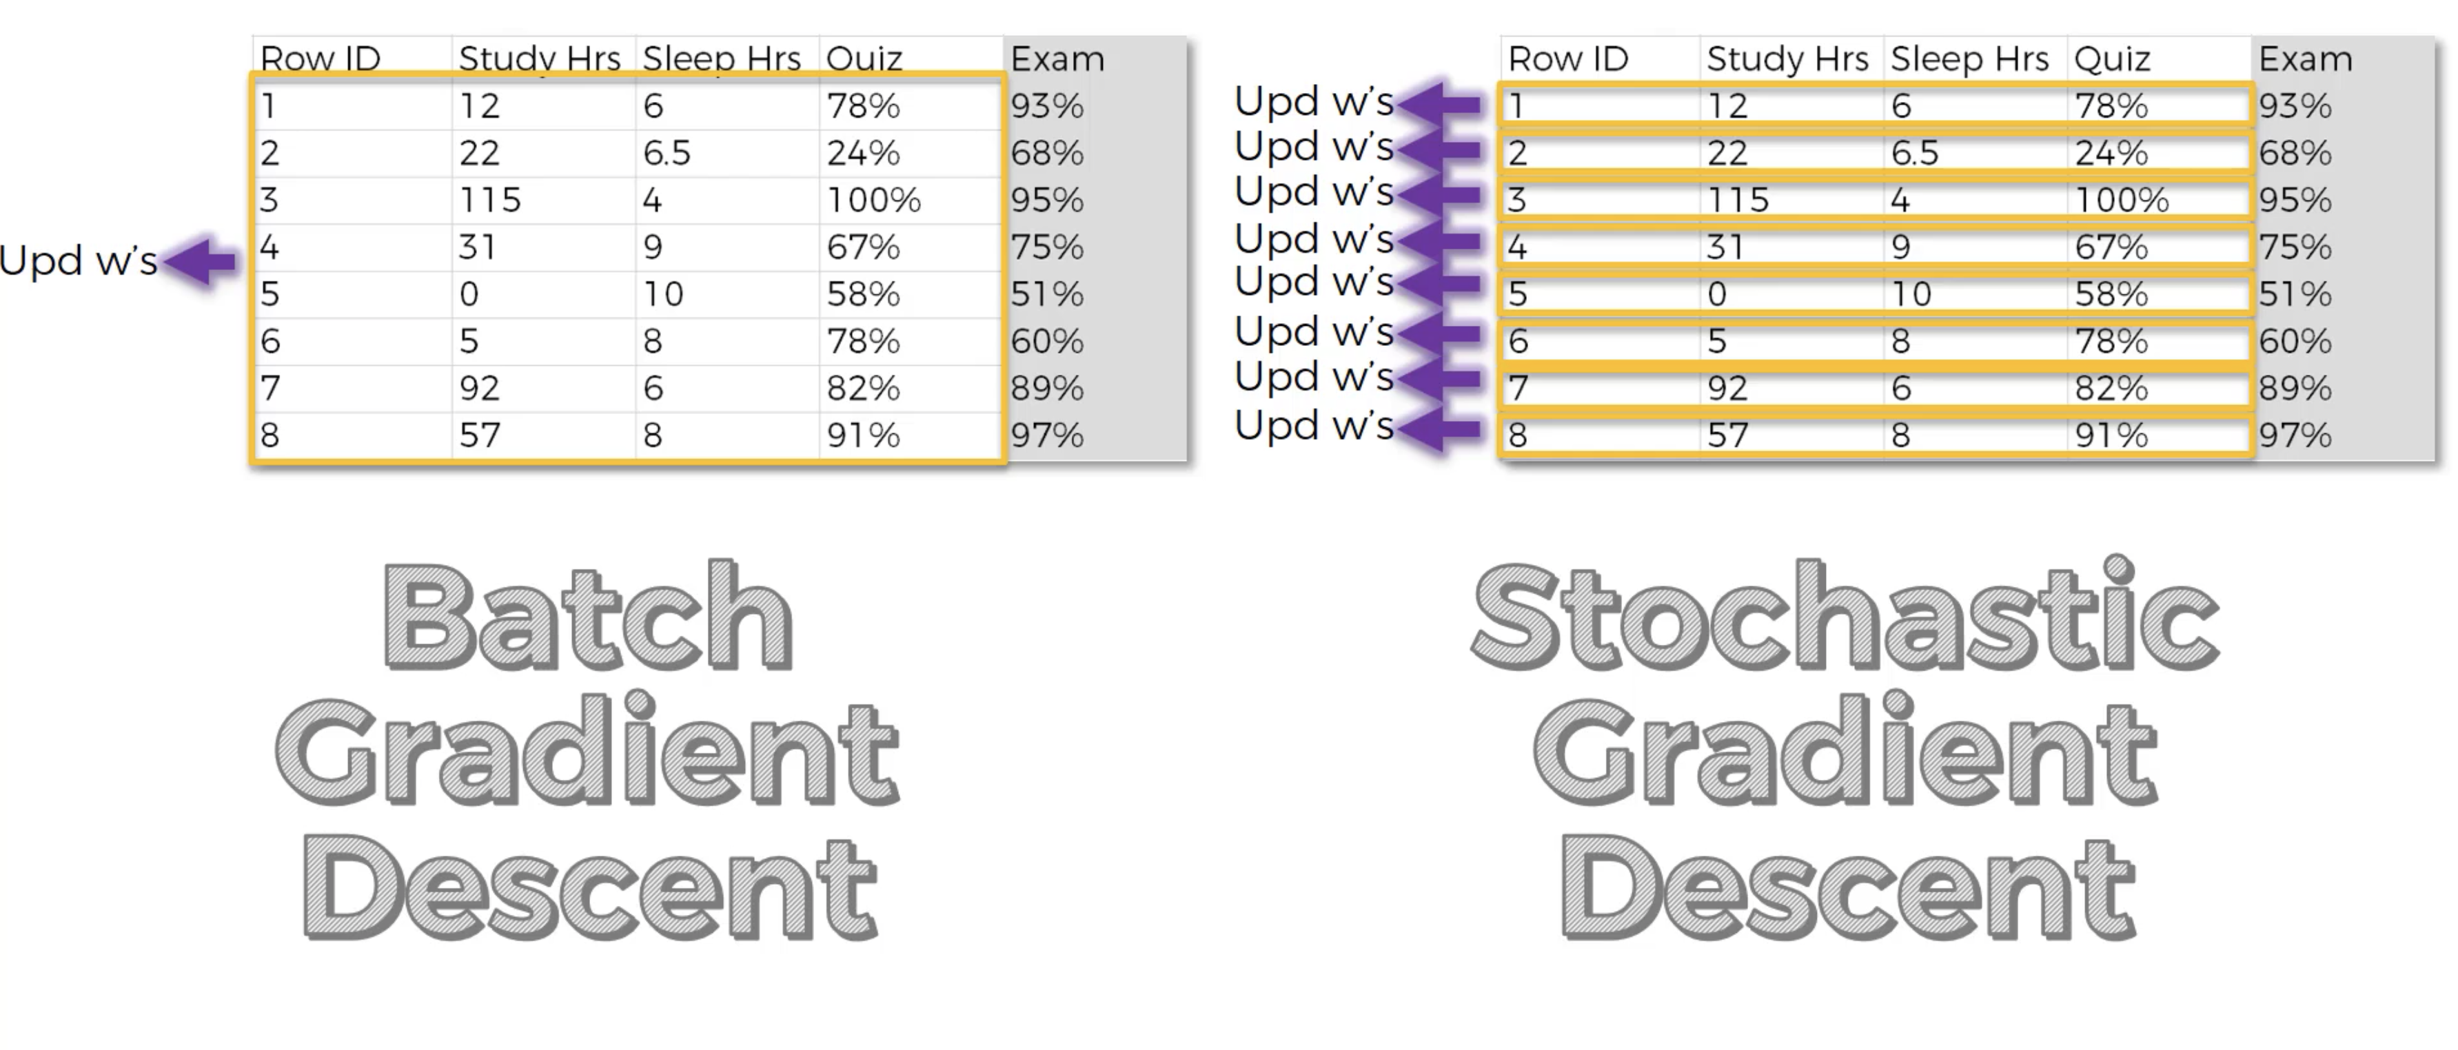
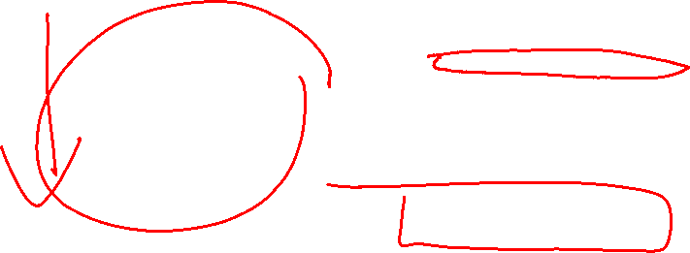
Optimizers (SGD vs Batch GD)
We do not need to update the weights using ALL observations
We still need to go over ALL observations (epoch)

Slide 24
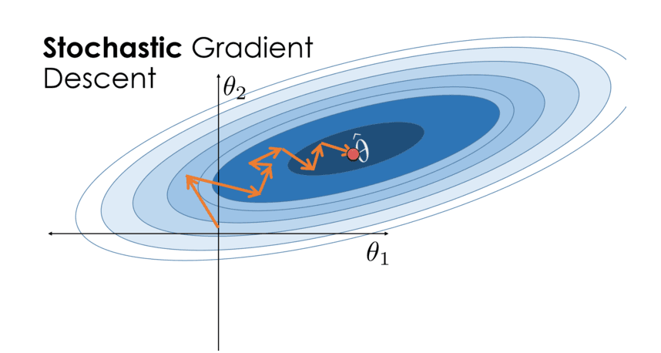


Optimizers (SGD)
We do not need to update the weights using ALL observations
We still need to go over ALL observations (epoch)

Slide 25

Batch Gradient Descent
We do not need to update the weights using ALL observations
A mini-batch can do as well
We still need to go over ALL observations (epoch)

Slide 26


Mini-Batch Gradient Descent
We do not need to update the weights using ALL observations
A mini-batch can do as well
We still need to go over ALL observations (epoch)

Slide 27
Python
Notes:
Guidelines
Use a title slide at the beginning of your presentation. There are 9 variations of title slides to choose from.
If you will have a series of slideshows, we recommend using the same style of title slide for each presentation.
Keep your title to no more than 2 lines.
Do not change the font style or font size of the title or subtitle.

Slide 28


Forward Pass
Hidden layers measure higher-order interactions
$$J\left(w\right)$$
$$b$$
$${ \hat{y}=f(w}^{⊤}x+b)$$

Slide 29

Forward Pass
Hidden layers measure higher-order interactions
$$J\left(w\right)$$
$$b$$
$${ \hat{y}=f(w}^{⊤}x+b)$$

Slide 30


Update
How do we update with activations and hidden layers?
$$∇J\left(w\right)=\frac{δJ(w)}{δw}$$
$$b$$
$${ \hat{y}=f(w}^{⊤}x+b)$$

Slide 31


Update
How do we update with activations and hidden layers?
$$∇J\left(w\right)=\frac{δJ(w)}{δf(z)}\frac{δf(z)}{δw}$$
$$b$$
$${ \hat{y}=f(w}^{⊤}x+b)$$

Slide 32


Dropout Layers
Regularization technique in neural networks that randomly sets a fraction of input units (neurons) to zero during training.
$$∇J\left(w\right)=\frac{δJ(w)}{δf(z)}\frac{δf(z)}{δw}$$
$$b$$
$${ \hat{y}=f(w}^{⊤}x+b)$$

Slide 33

L₁ (Lasso) / L₂ (Ridge) Layer Regularization
Prevents overfitting by adding constraints to a model’s parameters.
$$∇J\left(w\right)=\frac{δJ(w)}{δf(z)}\frac{δf(z)}{δw}$$
$$b$$
$${ \hat{y}=f(w}^{⊤}x+b)$$

Slide 34
Python
Notes:
Guidelines
Use a title slide at the beginning of your presentation. There are 9 variations of title slides to choose from.
If you will have a series of slideshows, we recommend using the same style of title slide for each presentation.
Keep your title to no more than 2 lines.
Do not change the font style or font size of the title or subtitle.

Slide 35


Everything is Vectorized
Suppose $y=\{0,1\}$
Cost function is the binary cross-entropy
Output layer has sigmoid activation function

Slide 36



Everything is Vectorized
Suppose $y=\{0,1\}$
Cost function is the binary cross-entropy
Output layer has sigmoid activation function

Slide 37

Everything is Vectorized
Suppose $y=\{0,1\}$
Cost function is the binary cross-entropy
Output layer has sigmoid activation function

Slide 38
Everything is Vectorized
Suppose $y=\{0,1\}$
Cost function is the binary cross-entropy
Output layer has sigmoid activation function

Slide 39
Everything is Vectorized
Suppose $y=\{0,1\}$
Cost function is the binary cross-entropy
Output layer has sigmoid activation function

Slide 40
Everything is Vectorized
Suppose $y=\{0,1\}$
Cost function is the binary cross-entropy
Output layer has sigmoid activation function

Slide 41
Everything is Vectorized
Suppose $y=\{0,1\}$
Cost function is the binary cross-entropy
Output layer has sigmoid activation function

Slide 42
Everything is Vectorized
Suppose $y=\{0,1\}$
Cost function is the binary cross-entropy
Output layer has sigmoid activation function
How weights are updated

Slide 43

Everything is Vectorized
Suppose $y=\{0,1\}$
Cost function is the binary cross-entropy
Output layer has sigmoid activation function
How biases are updated
All updates are done here

Slide 44
Python
Notes:
Guidelines
Use a title slide at the beginning of your presentation. There are 9 variations of title slides to choose from.
If you will have a series of slideshows, we recommend using the same style of title slide for each presentation.
Keep your title to no more than 2 lines.
Do not change the font style or font size of the title or subtitle.

